Slide 1
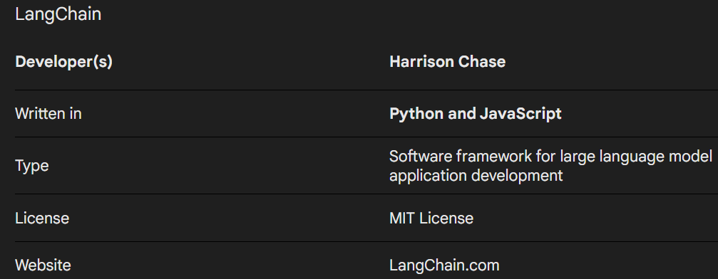

LANGGRAPH BOOTCAMP
Langgraph is platform build on top of Langchain.
Lets understand Langchain ecosystem, then we understand the Langgraph .
Lang Chain was launched in October 2022 as an open source project by Harrison Chase
LANGCHAIN vs LANGRAPH vs LANGSMITH
https://www.langchain.com/

Slide 2
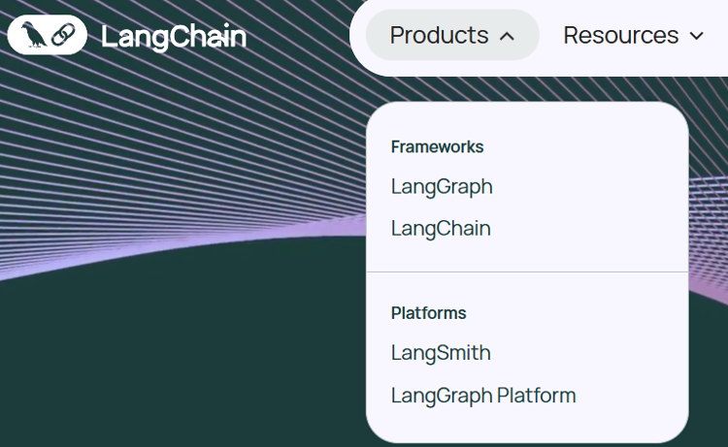
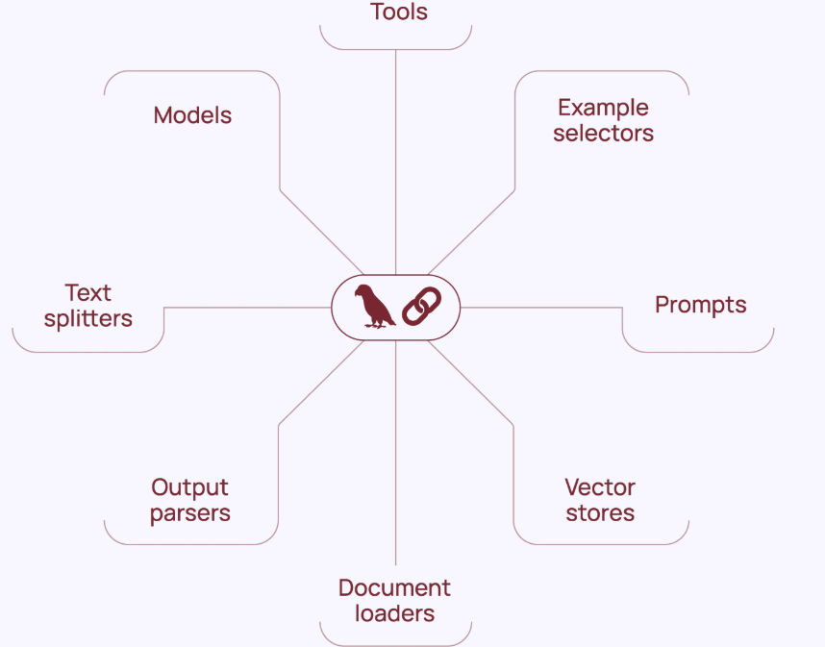
LANGCHAIN
Under LangChain ecosystem products are – Framework & platforms
Framework – Langchain & Langgraph || platforms – LangSmith & Langgraph platform

Slide 3
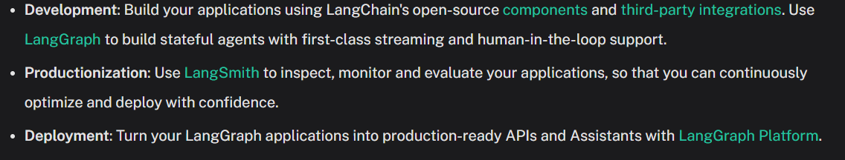
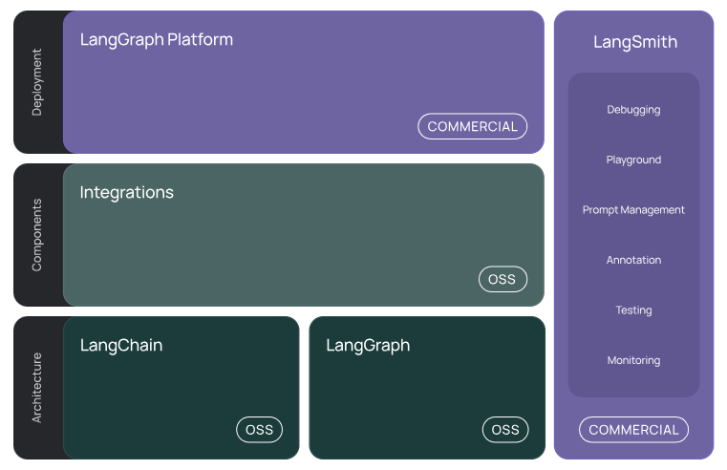

Slide 4
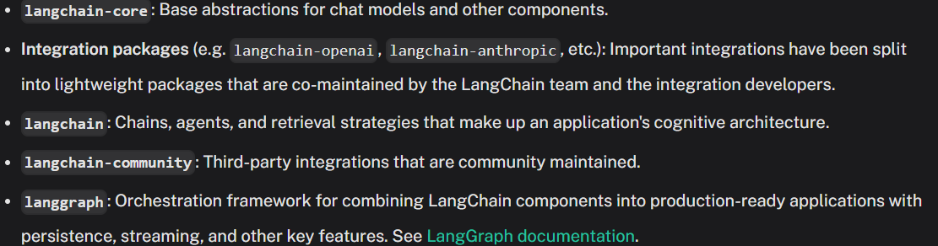
LANGCHAIN ARCHITECTURE
Langchain-core
Integration packages
Langchain
Langchain-community
Langgraph

Slide 5
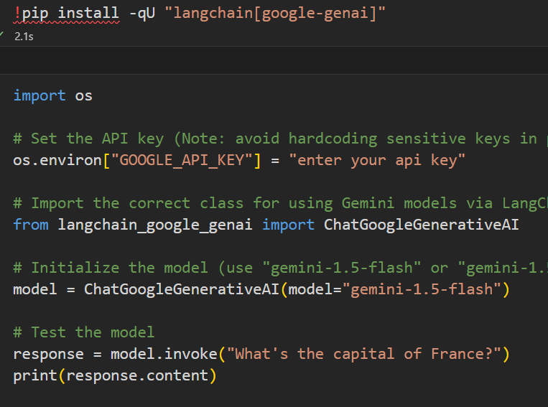
Langchain Practicle
https://python.langchain.com/docs/introduction/
LangChain’s flexible abstractions and AI-first toolkit make it the #1 choice for developers when building with Generative AI.
https://www.deligence.com/what_is_langchain_ai_app_development_framework_explained/

